Slide 1


Coding in public: recognising vulnerability as a barrier to reproducibility
IASSIST Conference 2024
Halifax, Nova Scotia
Copyright © 2021. Created by Computational Social Science Training Team, UK Data Service.
Notes:
Hello and thank you for coming to my presentation on Coding in Public.

Slide 2

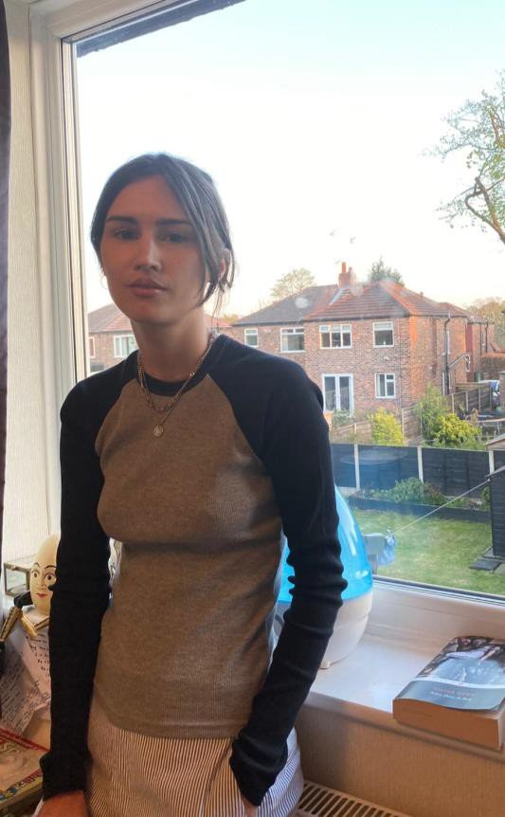
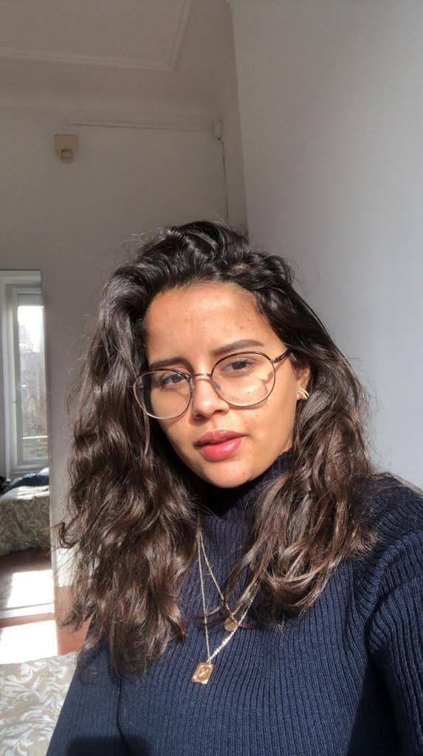
Who we are
Dr. Jools Kasmire Jupyter notebooks
Raise awareness of repositories with executable code and data
Louise Capener Python
Being more purposeful with code commenting
Nadia Kennar
R
Ensure all research documents and code are obtainable and organized
Notes:
My name is Dr. Jools Kasmire and I typically work in jupyter notebooks. My reproducibility goal is to raise awareness of repositories with executable code and data.
My two colleagues on this research project are Louise Capener and Nadia Kennar, both from the UKDS and who work in python and R respectively.
Their reproducibility goals are to become more purposeful with code commenting and to ensure all research documents and code are obtainable and organised.

Slide 3
Table of Contents
The workshop
Emergent themes and barriers
How barriers intersect with intersectionality
Recommendations for the future
Notes:
Briefly, I will start by describing the Reproducibility workshop we ran in which we collected all the data.
Then I will describe the themes that emerged from that data.
Following that, I discuss how reproducibility as a barrier intersects with intersectionality.
I conclude with some hopeful if possibly blithesome recommendations for the future.

Slide 4
The workshop - single “full day” of 3 sessions
Free, with 3 practical sessions, lunch and drink breaks provided
Time for practical, hands-on work, questions and discussion, etc.
Ethics approval granted for an extended focus group
8 social scientist participants, aged over 18 from research institutions (academic and governmental)
37 interactive anonymous polls, free text entry, word clouds, etc.
Plus notes taken on comments, questions, etc. during discussion
Thematic analysis of mentimeter responses and notes taken
Notes:
We advertised for a free, in-person, full-day workshop with lunch and drink breaks provided. The day had 3 different sessions, each with useful learning points as well as some practical hands-on work and plenty of time for questions and discussions, for example helping participants to create a github account, create Digital Object Identifierss, practice writing code comments, and so on.
Ethics approval was granted for what turned out to be a sort of extended focus group.
We had 8 participants, all social scientist participants over 18 years of age who agreed to participate, were free to leave at any time, and were made aware that all potentially delicate questions were optional and anonymous. The data was collected through 37 interactive, anonymous polls, free text entry forms, word clouds and the like via mentimeter as well as notes taken on comments and questions that arose in the discussion periods.

Slide 5
Session 1 - What is reproducibility? Why care?
Introduce reproducible research as a clearly written recipe
Repercussions, drivers, potential solutions, etc. of crisis
Majority had heard of reproducibility
Majority had tried to reproduce a project
Participants cared about reputation and creating good work
Lack of clarity over responsibilities and practical actions
Notes:
The first session started by exploring reproducible research, which I compared to a clear recipe, very unlike the recipes in the technical challenge portion of the great British bake off.
We also discussed the crisis of reproducibility including its repercussions, drivers, possible solutions and more.
Most of the participants understood a bit about reproducibility and recognised it as part of the scientific method.
Helpfully, most of them had also tried to reproduce some research, either their own or someone else's.
It was clear that participants cared about reputations, their own, their research institution’s, their fields and the wider reputation of science and research.
But it was also clear that participants felt real out to sea about exactly how to **do** reproducible research.

Slide 6
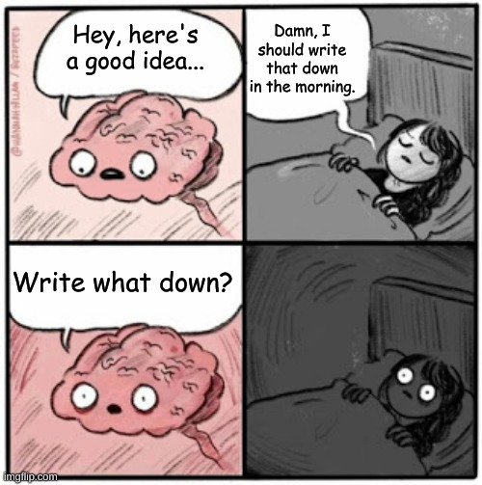
Session 2 - Habits, communication, documentation
Notes:
Session two got into some practical strategies for reproducibility as they relate to habits, communication and documentation.
This session emphasized that brains are good for having ideas, not keeping them, as is humoursly illustrated by this comic.
We also discussed how good science and reproducible research begins with letting go of the idea that clever people remember everything and instead embracing the option of writing EVERYTHING down.
I introduced a few clear strategies and processes for building the kind of habits that improve communication, which when formalised becomes useful documentation and that, in turn, improves reproducibility.
I shared how good habits, communication and documentation are useful in a range of contexts from peace of mind to career progression and conflict resolution.
This session ended with how good research habits, clear communication and useful documentation are beneficial for the researcher and their team in the present but also to the researcher and other researchers in the future.

Slide 7
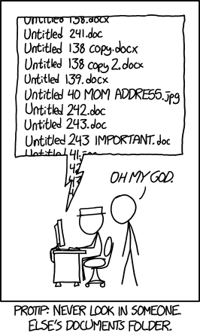
Session 3 - Tools, code, data sharing
Notes:
The third session was also very practical.
It focused on tools, code and data sharing solutions such as online repositories, version control, DOIs, and more and how these make it easier to write and share good research recipes.
This session looked at common research problems and potential solutions that make it easier to have good habits.
For example, in the comic here, the problem is that no one, maybe even including the original researcher, is going to stand a chance of finding the right file. The solution I suggest is to combine version control software with agreed naming and storage conventions in a shared cloud repository. Then, everyone involved can find the right file, even after a long time has passed and the “right file” is no longer in working memory. That is, neither in the human working memory or the “recent files used” memory on the computer.
This session emphasised that it is not an all-or-nothing situation and that there is benefit even from some of the people using some of the tools.
We also covered a few solutions for some of the contexts that were especially unclear, like when working with secure data.

Slide 8
Emergent theme 1 - Does it apply to me?
Unclear on how reproducibility works for
“soft” sciences
Secure data
Qualitative research
Need for clear training and/or examples
Need support to get started, test new approaches, etc.
Notes:
So, the first theme to emerge was “Does it apply to me?”.
In effect, social scientists knew about reproducibility as a concept but had not really seen it in action and didn’t know how make their work reproducible, especially as it relates to secure, qualitative or “soft” science methods.
For example, most researchers would just assume there was nothing to be done if they worked with secure data and could not share it. In the workshop we discussed options like
Creating a github repo even if they had no code or data to share (it can still share things like their participant information sheet, their ethical approval, etc.)
creating a synthetic data set, or
creating very detailed metadata , or
lodging their data with UKDS under a restricted access agreement.
All of these things are steps toward reproducibility and apply for any “soft science” or qualitative research project.
These, as well as many other steps, make the recipe clearer, even if it cannot be as totally clear.

Slide 9
Emergent theme 2 - Vulnerability
Imposter syndrome
Fear of criticism/doing it wrong/code anxiety
Getting “scooped”
Reporting negatives is never easy
Lack of time, resources, clear support to gain confidence
Lack of encouragement or expectation to try new things
Sometimes even lack of permission to try new things
Notes:
The second theme was around vulnerability. In essence, researchers weren’t very keen to engage with reproducibility because they were afraid.
They were afraid of making mistakes that might be mocked, criticised or that might “Break the project”. I hear things like this a lot, for example, around learning to code because they were afraid that they will delete the mainframe or something and cost everyone the entire project.
They also reported being afraid of having their ideas stolen.
They also report being afraid to share their research in case someone finds negative results. There are problems around publishing negatives results, throughout research and this is slowly changing but maybe not fast enough.
But a lot of the fear and vulnerability came from having to do all the learning and all the work on their own because there was insufficient provision within their formal degree training and a lack of encouragement or opportunities to self-educate on the topic.
In my own personal experience, there were even cases of not getting permission to use reproducible tools or services because it was out of the PI’s personal experience.

Slide 10
Emergent theme 3 - Reproducibility is a burden
No time planned within a grant to deal with reproducibility
No (clear) publication requirements or standards
Unclear on how to get credit for reproducibility work
Best when well-planned, well-communicated, fully participative
Useful tools may not be planned, budgeted, available, etc.
Poorly done means more time and intensive manual work needed
Notes:
The third theme was that at present, and to those who have no experience, reproducibility ONLY seems like more work.
Even worse, it seems like more of the worst kind of work.
The kind of work that is unclear, unsupported, without good examples.
The kind of work that you can’t put on your CV or that won’t help you get promotion.
The kind of work that is a huge hassle because there is always that one team member who keeps sending documents with new, impenetrable named word documents as attachments in email instead of using the version-controlled cloud storage.
And SOMEONE has to download that tracked changes document, manually copying over the changes, store it properly and confirm with the uncooperative team member that the changes have been made, etc.

Slide 11
Reproducibility is currently a barrier without
Practical support: training, time, tools, mentoring, leadership, examples, standards, best-practice guidance, etc.
Opportunities: to do and/or publish reproducibility efforts, ways to publish code/data, paid support to do reproducibility work, etc.
Culture change: value transparency, adjust image of “intelligence” or “academic”, reduce pressure on research positions, change funding/publication/promotion criteria, DEI efforts in academia, etc.
Notes:
All of these themes mean that reproducibility is, for many, a barrier unless there is
Practical support
Opportunities
And culture change.
However, the barrier of reproducibility does not affect all researchers equally.

Slide 12
Barriers and intersectionality
Workplace pressures matter.
Some researchers feel those pressures more.
Reproducibility is more of a barrier to more pressured researchers.
Notes:
Which is how reproducibility as a barrier intersects with intersectionality.
Precarious work, low pay, long hours, tight budgets, looming deadlines plus pressure to publish, get funding, get promotion, etc.
Think about all the pressures in a research workplace drive researcher burnout, competitive in-fighting, or that contribute to leaky pipelines.
Now how do you think reproducibility, which feels unclear, vulnerable and burdensome, plays out in this environment?
Researchers will feel this pressure more if they are less established, part-time, career-change, interdisciplinary and/or from marginalised groups like women, disabled, people of colour, working class, immigrants or refugees, carers, LGBTQIA+ or otherwise those who may not see themselves as stereotypical academics or as part of the “in-group”.
In this context, the barrier of reproducibility is even more of a barrier to these pressured researchers.
Importantly, we didn’t look at protected characteristics in our participants and did not ask them to disclose such characteristics, but we did urge them to reflect on how such characteristics might affect them or those they knew of.

Slide 13
Recommendations for the future
Be the change you want to see in the world.
Give your team the support and resources they need.
Can you create opportunities?
Change your own culture.
Notes:
So, my cheerfully optimistic recommendations for the future are to start doing the things that you want to see done.
This means providing the support that you want to see provided, although that support will look different in different teams. It might mean requesting funding for the useful software, creating a clear and agreed upon comms plan, or even reaching out to that persistent email-attachment person to understand why they are not using the version control repository.
It also means creating the opportunities you want created. Can you hire an intern to test your project’s reproducibility? Can you add something about code and data sharing to your project proposal? Can you ask your university ethics approval team to make reproducibility an ethical requirement? Can you approve time for a team member to volunteer for the Turing Way (an open-source handbook to reproducible and ethical research)?
Finally, it also means changing your own culture. Reflect and see if you are putting unfair support, opportunities, and work tasks onto your team that might be entrenching existing patterns. Make sure your team knows when you feel unsure of yourself or vulnerable so they can see that good researchers are not impervious or perfect. Make a real effort to write useful commit log messages when you commit to version control repositories.

Slide 14
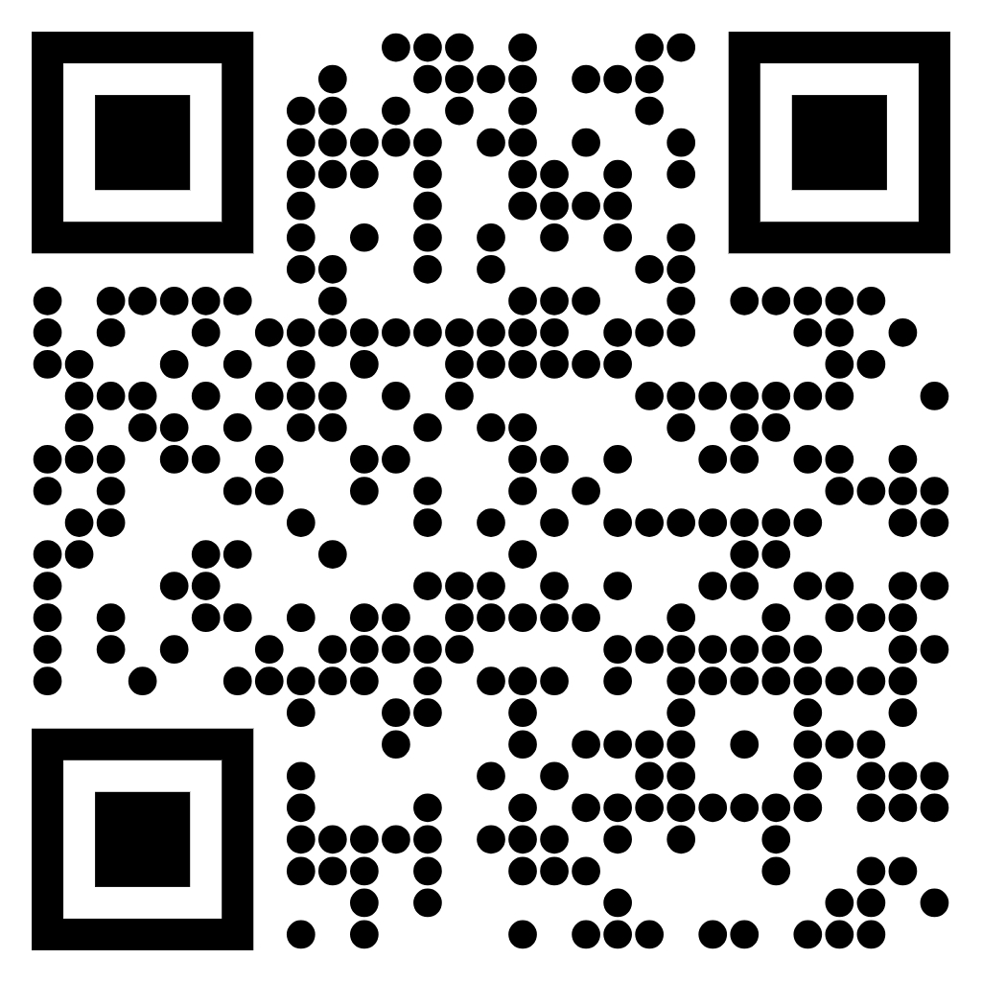
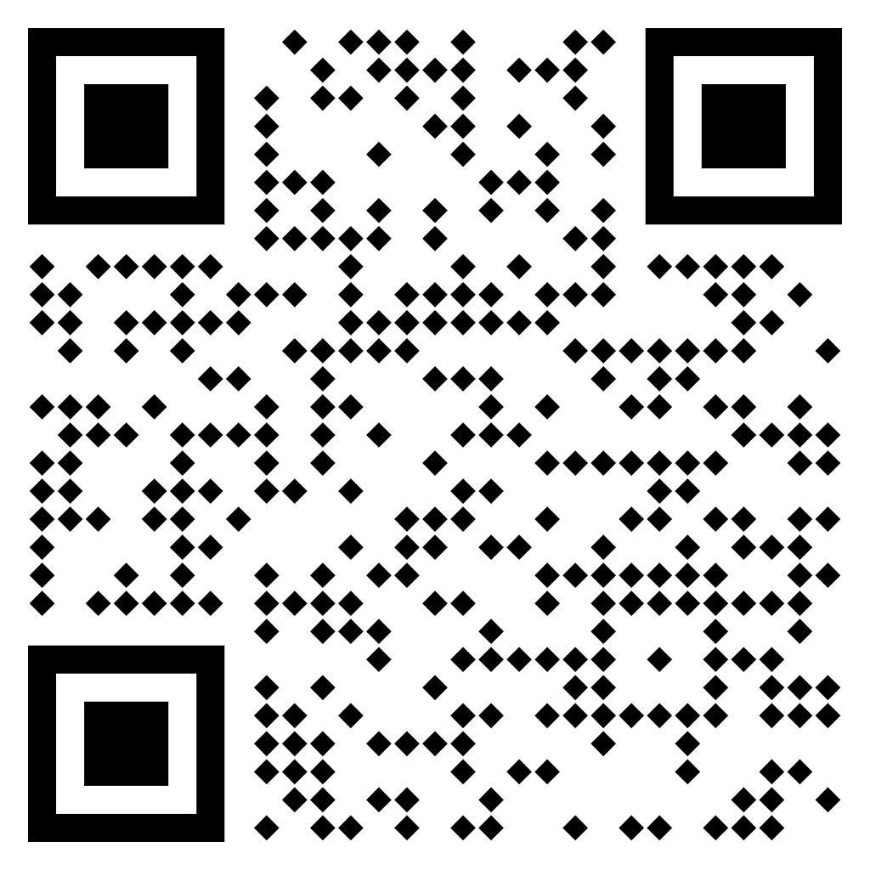
Contact details
https://github.com/
UKDataServiceOpen/Coding_in_public
j.kasmire@manchester.ac.uk
@JKasmireComplex
https://zenodo.org/records/11240729
Notes:
Because I try to walk the walk, here are links to my public github repository with all the resources, slide decks and data from the workshop and to a DOI I created of that repository.
Thanks very much and please do reach out if you have questions or want to talk to me.

